Slide 1

Team Name: AGROBOTSZ…
Team Leader Name: KARTHIK RAJA SK
Problem Statement Title: ORAL CANCER DETECTION USING DEEP LEARNING
Problem Statement Domain: MEDICAL FIELD
Make a copy of this template

Slide 2
Problem Statement Details
Reliance on Naked Eye Examination:
Doctors primarily rely on visual inspection to identify suspicious lesions or abnormalities in the mouth.
Naked eye examination alone may not always provide a definitive diagnosis of oral cancer.
Need for Additional Tests:
Confirmation of oral cancer often requires supplementary tests beyond visual inspection.
This adds complexity, time, and cost to the diagnostic process.

Slide 3
Tech Stack
Deep Learning Frameworks(keras,Tensorflow)
Python Libraries
Processing Tools
Image Model Evaluation
Deployment

Slide 4
Idea/Approach Details
An automated system for the early detection of oral cancer using deep learning and image analysis.
Implemented advanced techniques, including NASNetLarge feature extraction and Stacked Sparse Autoencoder (SSAE) model training.
user-friendly graphical interface for seamless interaction and visualization of diagnostic outcomes

Slide 5
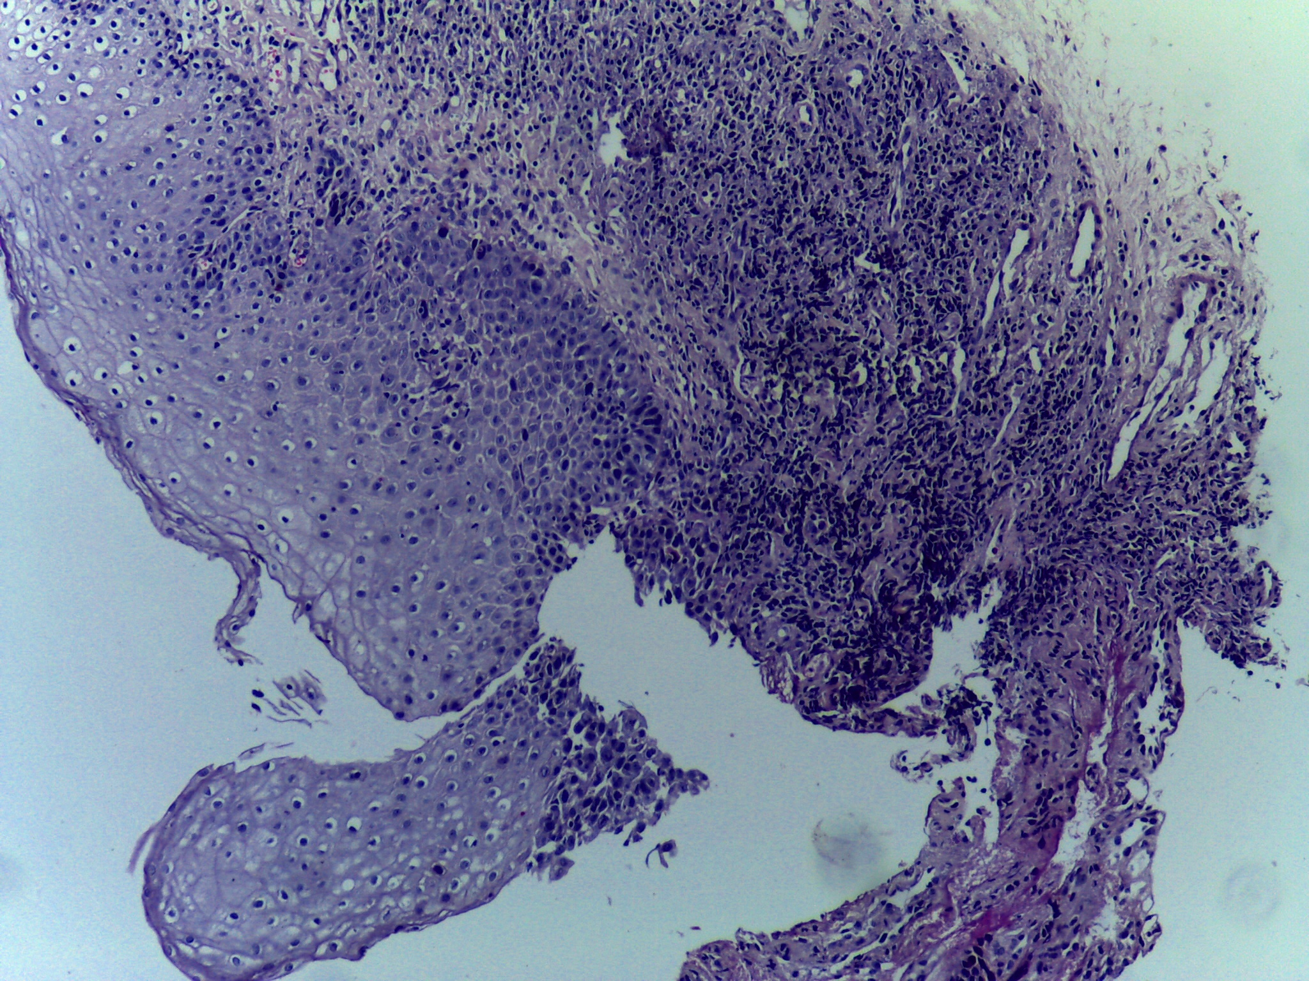
Our project depends on majorly on the datasets only and deep learning algorithms. We also use the Libraries like
Keras
Tensorflow
Pytorch
NASNetLarge

Slide 6
THANK YOU

